Slide 1
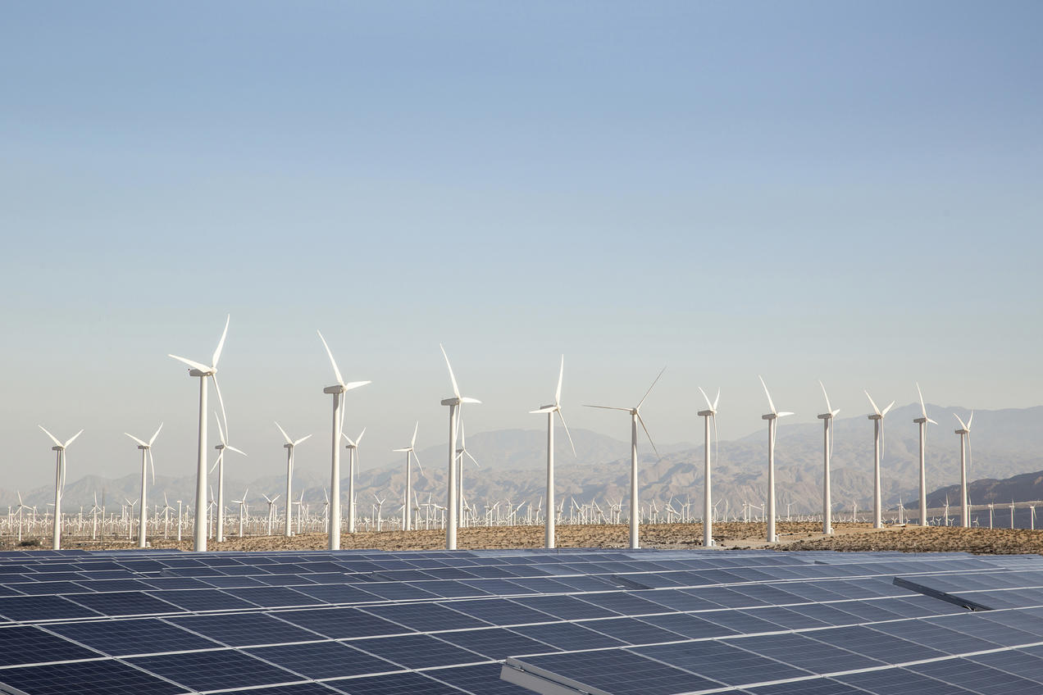
Name:-Santu jana sem:-4th batch:-cs&t sub:-DLS-(II) Reg:-D192025958 ROLL:DGITCSTS3 N0:10026308

Slide 2
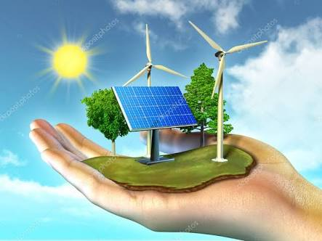
RENEWABLE ENERGY

Slide 3
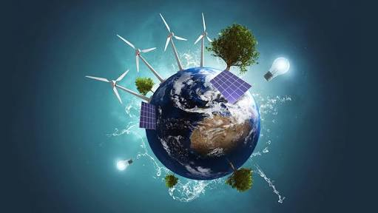
Enrgy:-Renewable enrgy,often refered to as clean enrgy,comes from narural sources or pocess that are constantly replenished. Fro ex:-sunlight or wind keep shining and blowing.

Slide 4
Types of RENEWABLE ENERGY SOURCES:- 1.Solar energy 2.Wind energy 3.Hydroprower energy 4.Geothermal energy 5.Biomass

Slide 5
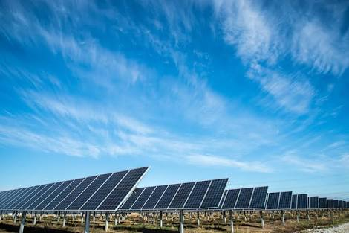
SOLAR ENERGY:-Solar power is the technology of obtaining usable energy from the light of the sun. Solar power energy has come into use where other power supplies are absent,such asin place off from the national electrical gird nd in space.

Slide 6
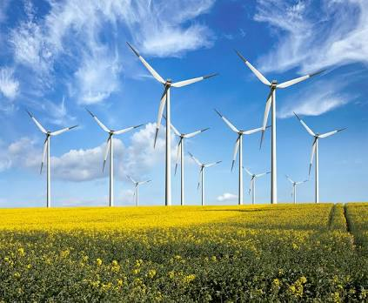
WIND ENERGY:-Wind power is using the energy of wind has been used since ancient times to move ships and for hundreds of years to pump water or grind corn and grain into flour, now it is usually changed into electricity using iwnd turbines.

Slide 7
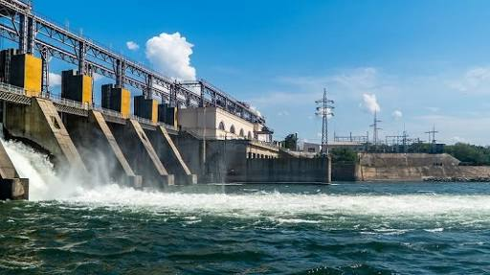
HYDROPROWER ENERGY:-Hydropower is changing the energy of moving water into more useful forms. Flowing water creates energy that can be captured and turned into electricty,.This is called hydroelectricity power or hydropower.

Slide 8
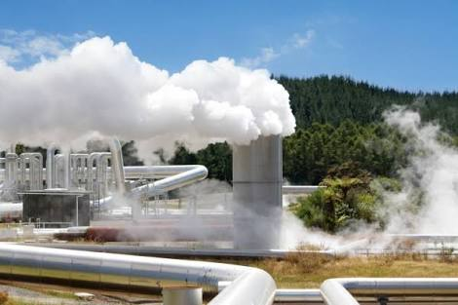
GEOTHERMAL ENERGY:-This type of energy is obtained by tapping the heat of the earth which is mostly in the from of hot water and steam. Various technology are used to get to the heat under the earth surface at different depths.

Slide 9

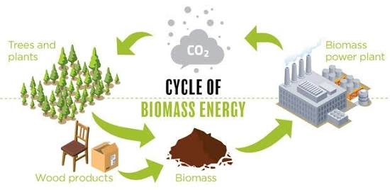
BIOMASS:-Biomass energy is the energy that is derived from organic matter of plants and animalis. Some of this is burne to make electricty,somme is made into bllogs,biofuel,like ethanol as a replacement for gasoline.

Slide 10
CREAT BY :-SANTU JANA

